Slide 1
IWT
(26CSE0106)
Dr. Kamal
Chitkara University Institute of Engineering and Technology
Chitkara University

Slide 2
Learning Outcomes
After this lecture, students will be able to:
Understand Web Technologies
Explain WWW evolution
Describe Internet Architecture
Differentiate Frontend & Backend
Understand HTTP/HTTPS
Explain DNS, URL, Domain Names
Understand Web Hosting

Slide 3
What is Web Technology?
Web Technology refers to the collection of technologies, tools, programming languages, and protocols used to create, develop, and maintain websites and web applications that run over the Internet.
Importance
Enables worldwide access to information and services.
Supports online communication, learning, shopping, and banking.
Provides interactive and dynamic web applications.
Forms the foundation of modern digital businesses.

Slide 4
Cont..
Characteristics
Platform Independent: Works on Windows, macOS, Linux, Android, and iOS.
Client-Server Architecture: Browser (client) communicates with the web server.
Interactive: Supports multimedia, animations, and user interaction.
Scalable: Can handle a small website or millions of users.
Accessible: Available anytime and anywhere with an Internet connection.

Slide 5
Cont..
Applications
E-commerce websites (Amazon, Flipkart)
Social networking sites (Facebook, Instagram)
Online banking and digital payments
E-learning platforms (Coursera, NPTEL)
Video streaming services (YouTube, Netflix)
Cloud-based applications (Google Docs, Microsoft 365)

Slide 6
Evolution of the World Wide Web
Year | Development | Explanation
1969 | ARPANET | ARPANET (Advanced Research Projects Agency Network) was the first computer network developed by the U.S. Department of Defense. It became the foundation of the Internet.
1983 | TCP/IP | TCP/IP (Transmission Control Protocol/Internet Protocol) became the standard communication protocol, allowing different computer networks to communicate with each other. This marked the beginning of the modern Internet.
1989 | WWW Proposed by Tim Berners-Lee | Tim Berners-Lee proposed the World Wide Web (WWW) at CERN. He introduced the concepts of HTML, HTTP, and URLs, making it easier to access and share information over the Internet.
1991 | First Website | The world's first website was launched by Tim Berners-Lee. It explained what the World Wide Web was and how people could create web pages.
1995 | Dynamic Websites | Websites became interactive using technologies like PHP, ASP, JavaScript, and databases. Users could log in, search, and interact with websites instead of viewing only static pages.
2005 | Web 2.0 | Web 2.0 introduced user-generated content and social interaction. Popular examples include Facebook, YouTube, Wikipedia, and blogs, where users could create and share content.
2010 | HTML5 | HTML5 was introduced with support for audio, video, graphics (Canvas), local storage, and responsive web design, reducing the need for plugins like Flash.
2020 | Progressive Web Apps (PWAs) | PWAs combine the features of websites and mobile apps. They can work offline, load quickly, send push notifications, and be installed on devices without using an app store.

Slide 7
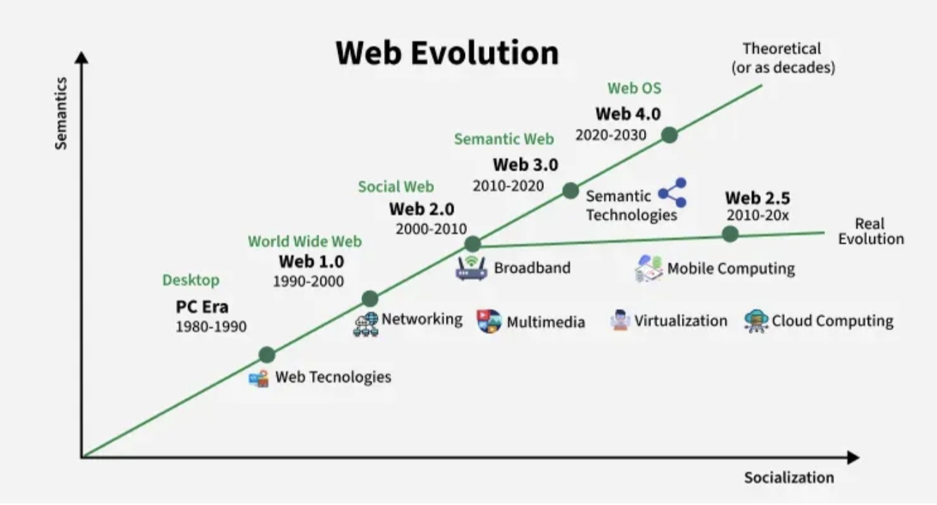
Cont..

Slide 8
What is Internet Architecture?
Internet architecture refers to the overall design and structure of the Internet.
The term Internet comes from Inter-Networking, which means connecting multiple independent networks.
It is based on the TCP/IP (Transmission Control Protocol/Internet Protocol) protocol suite.
TCP/IP provides a standard set of communication rules that enable different types of networks to communicate with each other.
This architecture allows networks with different hardware, software, and technical designs to exchange data seamlessly.
It ensures reliable, scalable, and universal communication across the Internet.

Slide 9
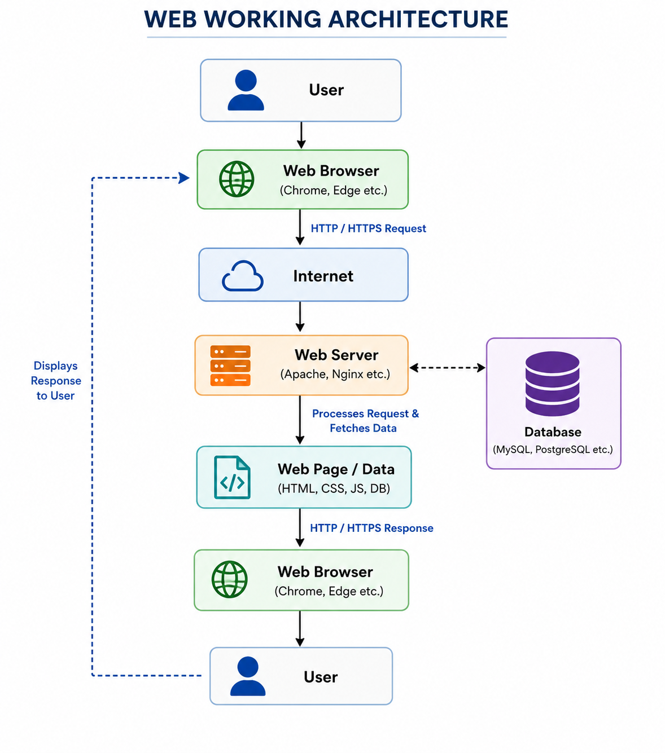
Cont..

Slide 10
Cont..
      You: “Show my result.”
          ↓
      Browser: Sends request
          ↓
      Internet: Carries request
          ↓
      Web Server: Receives request
          ↓
      Database: Finds your marks
          ↓
      Web Server: Creates result page
          ↓
      Browser: Receives the page
          ↓
      You: See your result

Slide 11
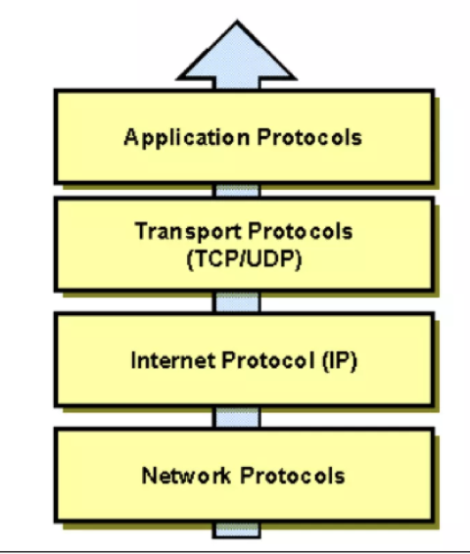
Cont..
Application Protocols
Provides network services directly to end-user applications.
Transport Protocols (TCP/UDP)
Ensures reliable or fast end-to-end data communication between devices.
Internet Protocol (IP)
Handles logical addressing and routes data packets across networks.
Network Protocols
Manages the physical transmission of data over network media.

Slide 12
Cont..
1. Application Protocols —
  This is the layer closest to the user.
  It provides services that applications use to communicate over the Internet.
    Examples:
    HTTP/HTTPS → Web browsing
    FTP → File transfer
    SMTP → Sending emails
    DNS → Finding the IP address of a website
Simple meaning: What service does the user want?

Slide 13
Cont...
2. Transport Protocols
  The main protocols are:
    TCP → Reliable delivery
    UDP → Faster delivery but less reliable
TCP makes sure data reaches the destination correctly and in the proper order.
Simple meaning: How should the data be delivered?

Slide 14
Cont..
3. Internet Protocol (IP)
  The IP layer is responsible for addressing and routing.
  Every device on a network has an IP address.
  For example:
    192.168.1.10
  IP helps decide where the data should go.
Simple meaning: Where should the data go?

Slide 15
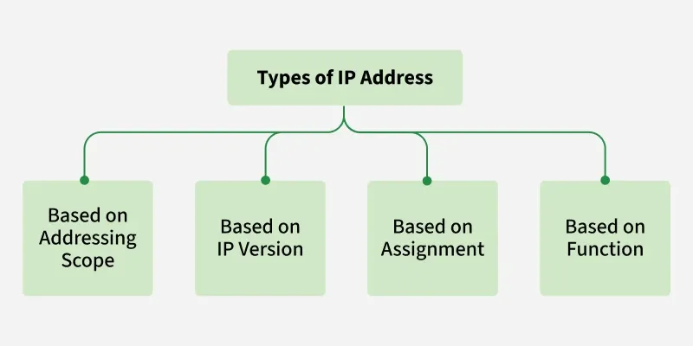
Type of Address

Slide 16
4. Network Protocols
  This is the lowest layer shown in the diagram.
  It deals with the actual movement of data through the network, such as Ethernet or Wi-Fi.
Simple meaning: How does the data physically/network-wise travel?

Slide 17
Internet vs World Wide Web (WWW)
Internet | World Wide Web (WWW)
A network of networks connecting millions of computers worldwide. | A collection of websites and web pages available on the Internet.
It is the hardware and communication infrastructure. | It is an information system that runs on the Internet.
Uses TCP/IP (Transmission Control Protocol/Internet Protocol) for communication. | Uses HTTP/HTTPS (Hypertext Transfer Protocol/Secure) to access web pages.
Supports many services like Email, FTP, VoIP, and the Web. | Provides access to websites, online documents, images, videos, and web applications.
Invented in the 1960s–1980s as a global communication network. | Invented by Tim Berners-Lee in 1989 to share information through web pages.

Slide 18
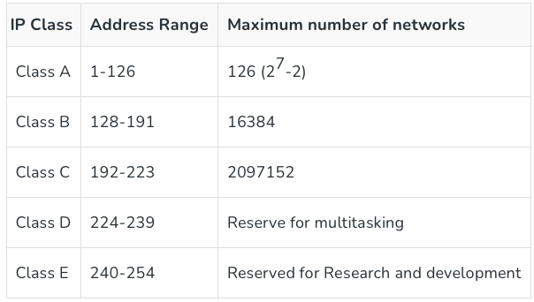
Classes of IPv4 Address

Slide 19
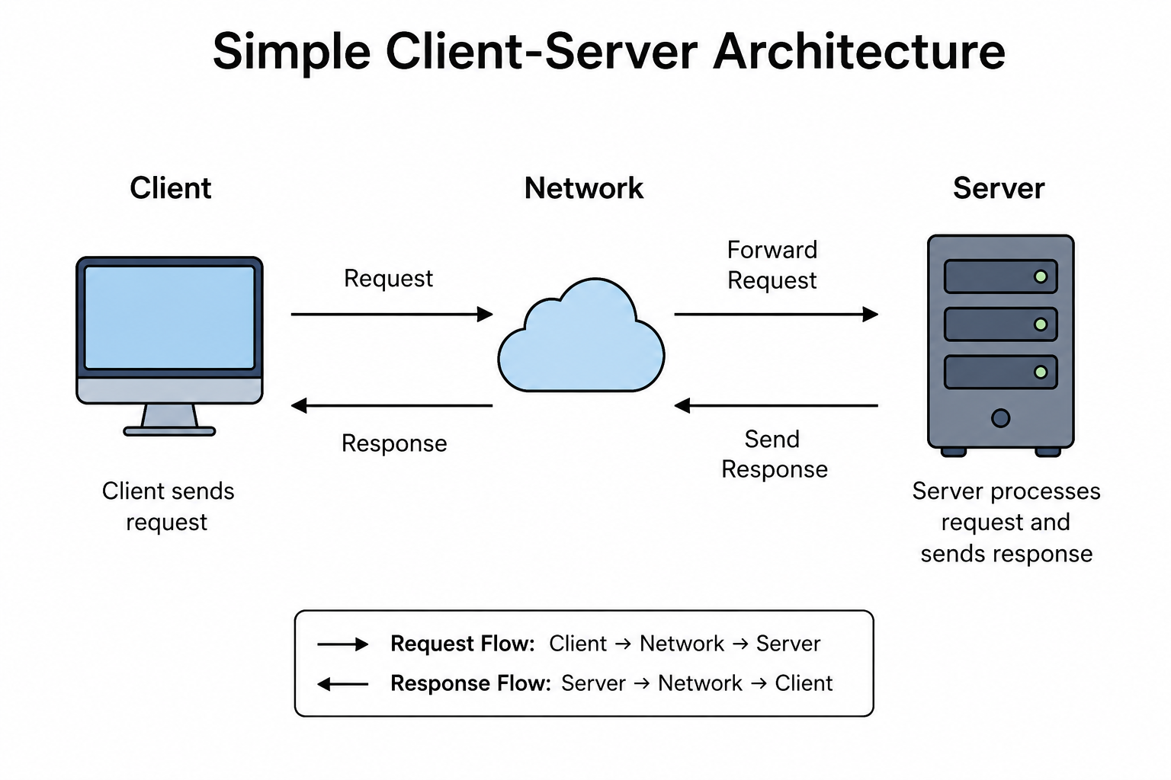
Client–Server Architecture

Slide 20
Cont..
What is a Client?
A client is a computer, laptop, workstation, or mobile device that users use to access applications and services. It sends requests to a server and relies on the server for resources such as files, databases, printers, and applications.
What is a Server?
A Server is a computer or software program that provides services, resources, or data to other computers (called clients) over a network.

Slide 21
Cont..
Example: Opening Google
When you open a website:
Application: HTTP/HTTPS → “I want this webpage.”
↓
Transport: TCP → “Deliver the data reliably.”
  ↓
Internet: IP → “Send it to the correct computer.”
  ↓
Network: Wi-Fi/Ethernet → “Move the data through the network.”
In short:
Application → Service
Transport → Delivery
IP → Address/Route
Network → Actual transmission

Slide 22
Types of Client-Server Architecture
2-Tier Architecture (Client ↔ Server)
In a 2-tier architecture, the application is divided between two systems:
  Client (User's Computer)
  Server (Database Server)
  3-tier architecture
  3-tier architecture, the application is divided into three separate layers, each running independently.
  Presentation Layer
  Application (Business Logic) Layer
  Database Layer

Slide 23
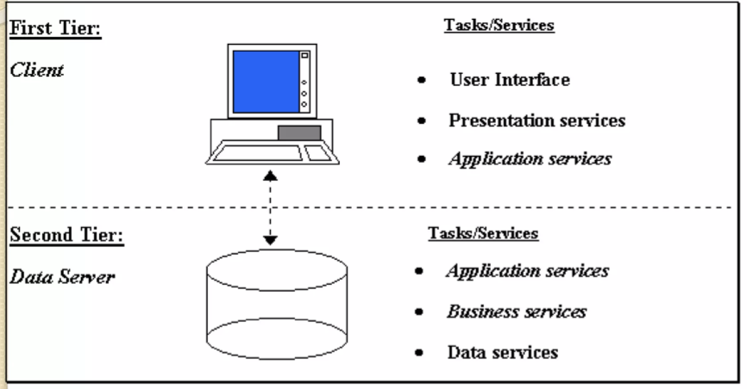
2-Tier Architecture

Slide 24
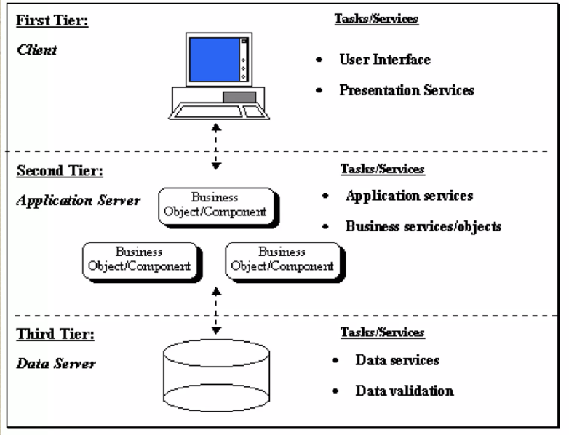
3-tier architecture

Slide 25
Difference Between 2-Tier and 3-Tier Architecture
Feature | 2-Tier | 3-Tier
Number of Layers | 2 | 3
Business Logic | Client | Application Server
Database | Server | Separate Database Server
Security | Lower | Higher
Scalability | Limited | High
Performance | Suitable for small applications | Suitable for large enterprise applications
Maintenance | Difficult | Easier
Examples | MS Access, Desktop Applications | Amazon, Flipkart, Banking Systems

Slide 26
Frontend and Backend Technologies
Frontend is the piece of the website users can see and interact with, for example, the graphical UI (GUI) and the command line, including the design, navigating menus, texts, images, videos, etc.
Backend, in actuality, is the piece of the site clients can't see and interface with. It's about how everything works.
Frontend vs. Backend
Frontend: The visible side. It's what users interact with – from buttons to animations.
Backend: The invisible side. Handles data, logic, and ensures everything works properly behind the scenes.
Collaboration: Both need to work in perfect harmony for smooth user experiences!

Slide 27
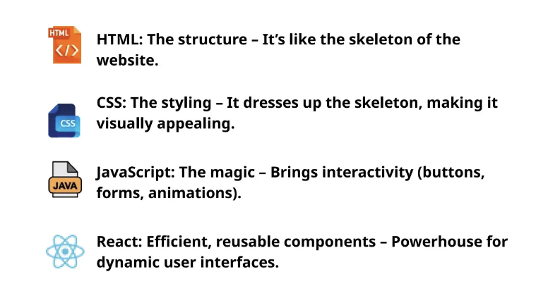
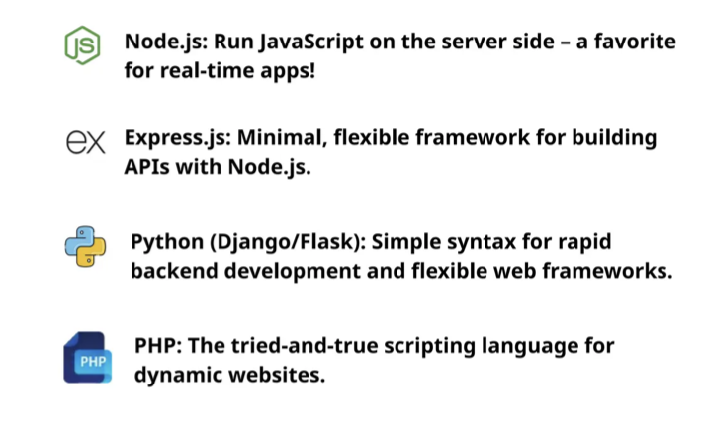
Popular Frontend and Backend Technologies

Slide 28
Static Website
In Static Websites, Web pages are returned by the server which are prebuilt source code files built using simple languages such as HTML, CSS, or JavaScript.
There is no processing of content on the server (according to the user) in Static Websites.
Web pages are returned by the server with no change therefore, static Websites are fast.
There is no interaction with databases. Also, they are less costly as the host does not need to support server-side processing with different languages.
Static does not mean that it will not respond to user actions, These Websites are called static because these cannot be manipulated on the server or interact with databases

Slide 29
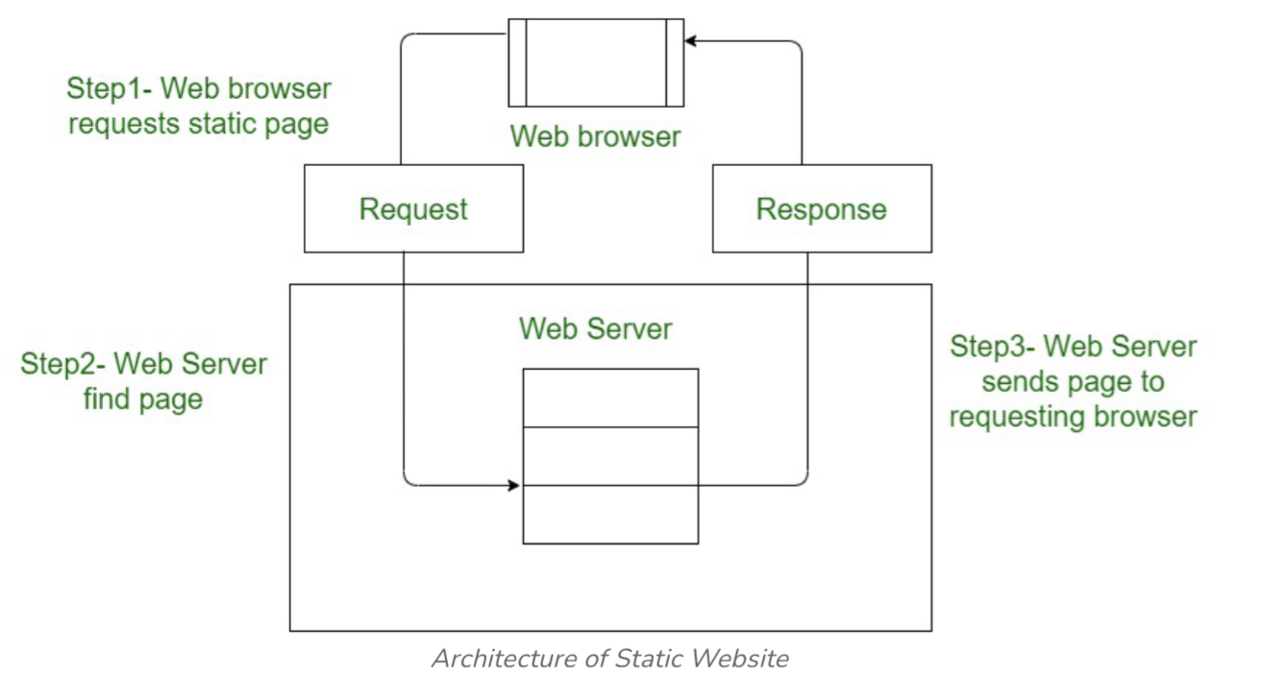
Architecture of Static Website

Slide 30
Dynamic Website
Dynamic Website: In Dynamic Websites, Web pages are returned by the server which are processed during runtime means they are not prebuilt web pages but they are built during runtime according to the user's demand with the help of server-side scripting languages such as PHP, Node.js, ASP.NET and many more supported by the server. So, they are slower than static websites but updates and interaction with databases are possible.
Dynamic Websites are used over Static Websites as updates can be done very easily as compared to static websites (Where altering in every page is required) but in Dynamic Websites, it is possible to do a common change once and it will reflect in all the web pages.

Slide 31
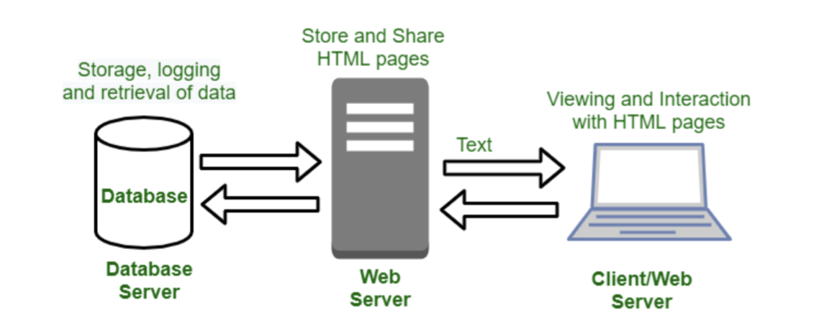
Architecture of Dynamic Website

Slide 32
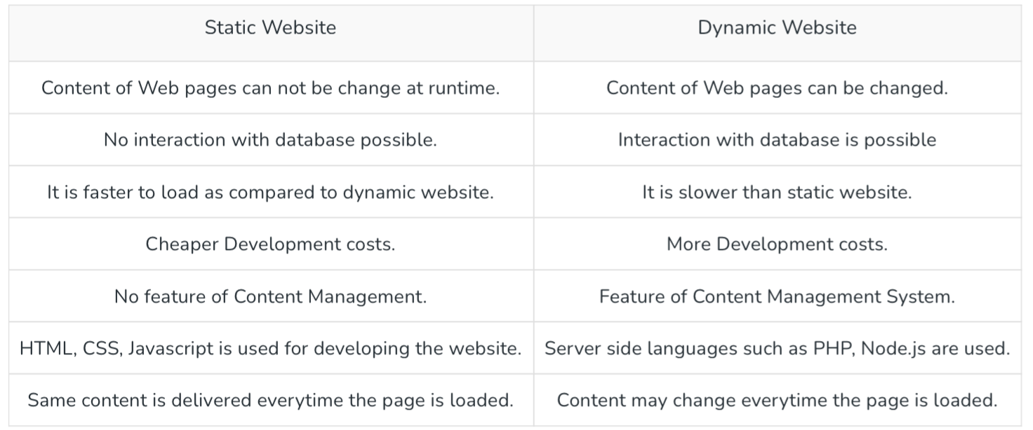
Difference Between Static and Dynamic Websites:

Slide 33
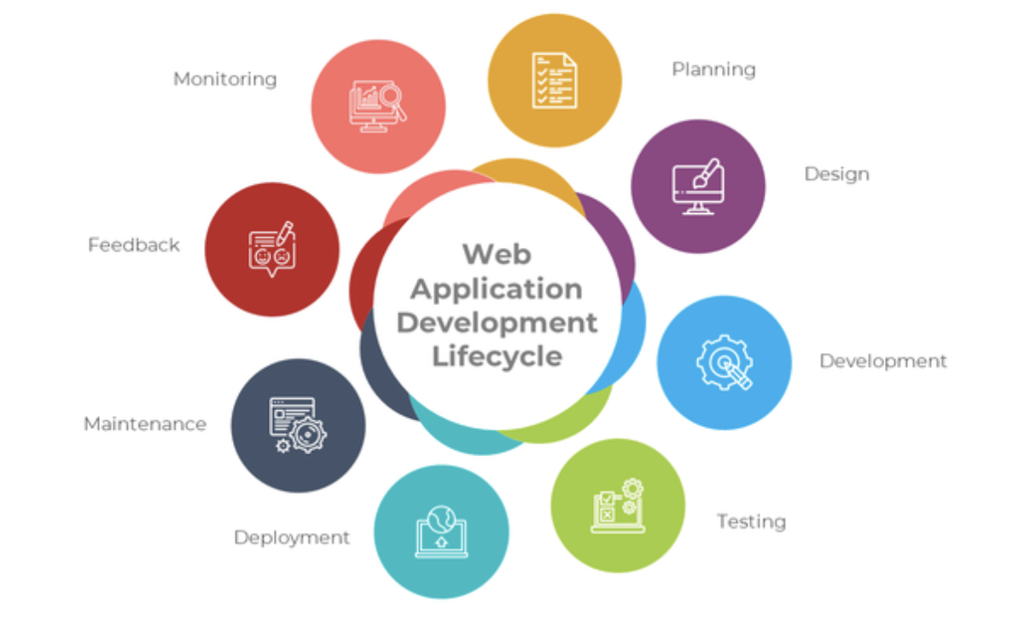
Web Application Lifecycle

Slide 34
Cont..
Stage | Explanation
Planning | Defines the project objectives, requirements, timeline, and resources before development begins.
Design | Creates the user interface (UI), user experience (UX), and overall architecture of the web application.
Development | Implements the application by writing the front-end and back-end code.
Testing | Verifies that the application is free from bugs and meets all functional and performance requirements.
Deployment | Launches the completed web application to the live server for end users.
Maintenance | Continuously updates, fixes bugs, and improves the application after deployment.
Feedback | Collects user suggestions and reviews to identify areas for future improvements.
Monitoring | Continuously tracks the application's performance, security, and availability to ensure smooth operation.

Slide 35
What is a Web Browser?
A Web Browser is a software application used to access, retrieve, and display web pages on the Internet. It communicates with web servers using HTTP/HTTPS protocols and renders HTML, CSS, and JavaScript into interactive web pages.
Popular Web Browsers
🌐 Google Chrome
🦊 Mozilla Firefox
🧭 Microsoft Edge
🍎 Safari
🎭 Opera

Slide 36
Browser Developer Tools (DevTools)
Browser Developer Tools (DevTools) are built-in utilities that help developers inspect, debug, and optimize websites.
Features
🔍 Inspect HTML elements
🎨 Modify CSS styles in real time
💻 Debug JavaScript
🌐 Monitor network requests
📊 Analyze website performance
📱 Test responsive web design

Slide 37
What is HTTP?
HTTP (HyperText Transfer Protocol) is a communication protocol used to transfer web pages and other resources between a web browser (client) and a web server.
It is the foundation of communication on the World Wide Web (WWW).
HTTP works on a request-response model.
It is stateless, meaning every request is independent.
http://www.example.com

Slide 38
What is HTTPS?
HTTPS (HyperText Transfer Protocol Secure) is the secure version of HTTP.
It encrypts the data exchanged between the browser and the web server using SSL/TLS.
It protects users from hackers, data theft, and tampering.
Used for online banking, shopping, email, login pages, etc.
      https://www.example.com

Slide 39
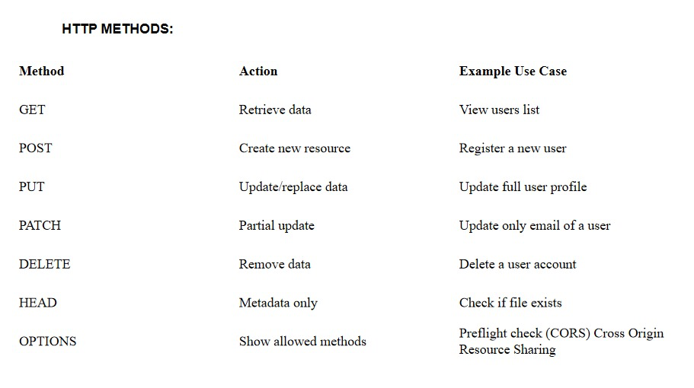
HTTP Methods

Slide 40
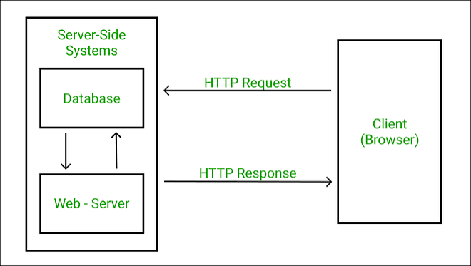

HTTP Request–Response Model

Slide 41
Difference between HTTP and HTTPS
Feature | HTTP | HTTPS
Full Form | HyperText Transfer Protocol | HyperText Transfer Protocol Secure
Security | Not Secure | Secure
Encryption | No encryption | Uses SSL/TLS encryption
Port Number | 80 | 443
URL | http:// | https://
Data Protection | Data can be intercepted | Data is encrypted
Authentication | No | Yes (SSL Certificate)
Speed | Slightly faster | Slightly slower due to encryption (difference is minimal today)
Used For | Normal websites | Banking, E-commerce, Login pages, Online payments

Slide 42
HTTP response status codes
HTTP response status codes indicate whether a specific HTTP request has been successfully completed. These are three-digit numbers sent by the server in response to a client's request.
Responses are grouped in five classes:
Status Code | Class | Meaning
100 – 199 | Informational Responses | The request has been received and processing can continue.
200 – 299 | Successful Responses | The request was successfully received, understood, and processed.
300 – 399 | Redirection Messages | Further action is required, usually to access the requested resource at another location.
400 – 499 | Client Error Responses | There is an error in the request made by the client.
500 – 599 | Server Error Responses | The server failed to fulfill a valid request.

Slide 43
DNS
DNS (Domain Name System) is a system that translates human-readable domain names, like www.example.com, into machine-readable IP addresses, such as 192.168.1.1, which computers use to identify and communicate with each other on the internet. Without DNS, we’d have to memorize IP addresses to access websites, making it difficult and inefficient for the average user.
Another way, Domain name is a way to identify and locate computers connected to internet.
No two organizations can have same domain name.
A domain name always consists of two or more components separated by periods called dots (.).
EXAMPLE: www.yahoo.co.in, www.facebook.com etc.
"DOMAIN NAME SYSTEM is a collection of the databases that contain information about domain names and their corresponding IP address."

Slide 44
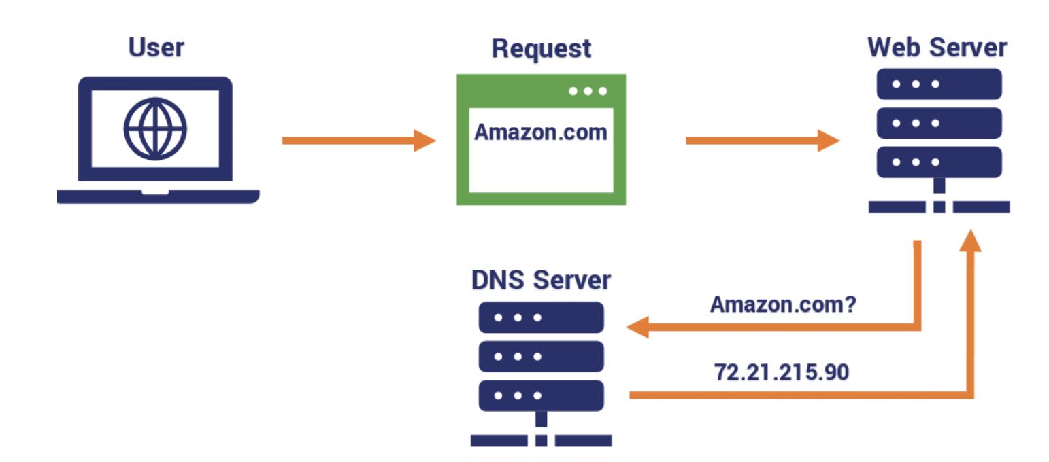
Cont...

Slide 45
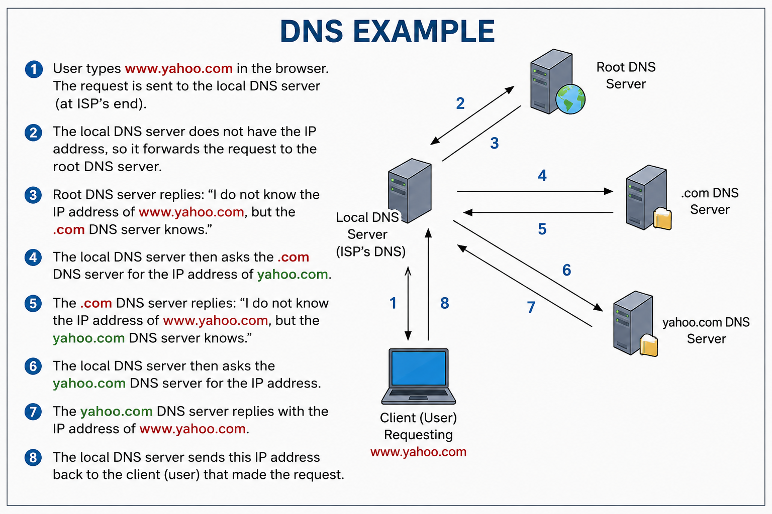
Cont..

Slide 46
Top-Level Domains (TLDs)
A Top-Level Domain (TLD) is the last part of a website address (domain name) that appears after the final dot (.). It indicates the type or purpose of the website or organization.
Each domain name has a corresponding IP address
When the user types the domain name in the address bar, the corresponding IP address is supplied. Such a translation is possible with the help of system called DNS (DOMAIN NAME SYSTEM)
LD | Full Form / Used For | Example
.com | Commercial organizations (Businesses) | www.amazon.com, www.yahoo.com
.net | Network organizations, Internet service providers | www.speedtest.net
.gov | Government organizations | www.india.gov.in (India), www.nj.gov (USA)
.edu | Educational institutions (mainly US universities) | www.harvard.edu
.org | Non-profit organizations | www.wikipedia.org
.mil | Military organizations (mainly US military) | www.army.mil
.int | International organizations | www.itu.int (International Telecommunication Union)

Slide 47
Geographical/Country Domains (ccTLDs)
Geographical or Country Domains are two-letter domain extensions that represent a specific country or region.
These domain codes are standardized by the International Organization for Standardization (ISO) under the ISO 3166-1 alpha-2 standard.
They help identify the country to which a website belongs.
Domain Country
.in India 🇮🇳
.jp Japan 🇯🇵
.us United States 🇺🇸
.fr France 🇫🇷
.it Italy 🇮🇹
.cn China 🇨🇳
.au Australia 🇦🇺

Slide 48
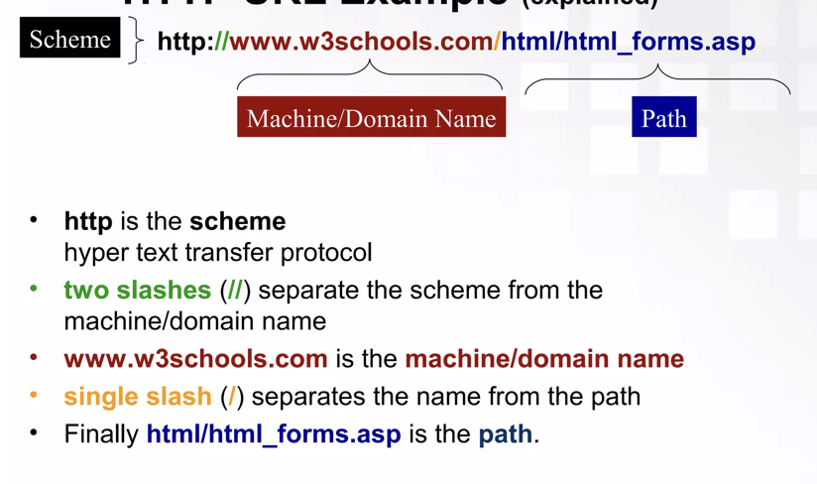
URL
A Uniform Resource Locator (URL) is a standard way developed to specify the location of a resource available electronically.
Example:

Slide 49
Cont..

Slide 50
Cont...
Absolute URL
This type of URL contains both the domain name and directory/page path. An absolute URL gives complete location information. It begins with a protocol like "http://" and continues, including every detail.
Relative URL
This type of URL contains the path excluding the domain name. Relative means "in relation to", and a relative URL tells a URL location on terms of the current location. Relative path is used for reference to a given link of a file that exist within the same domain.
Absolute URL | Relative URL
Contains full address | Contains only the path
Independent of current page | Depends on current page location
Used for external resources | Commonly used for internal resources
Example: https://example.com/page.html | Example: page.html

Slide 51
Query Parameters
Query parameters are pieces of information added to the end of a URL to send data to a web server.
They are written after a ? in the URL.
  https://example.com/search?q=computer
  Here:
    https://example.com/search → URL
    ? → Starts the query parameters
    q → Parameter name
    computer → Parameter value
  So, q=computer means the search term is computer.
  Multiple Query Parameters
  Multiple parameters are separated using &.
  https://example.com/products?category=mobile&brand=apple
  Here:
  Parameter Value
  category mobile
  brand apple
  The server receives both pieces of information.

Slide 52
Cont..
POP3
POP3 (Post Office Protocol Version 3) is an application layer protocol used to receive/download emails from a mail server to your device.
SMTP (Simple Mail Transfer Protocol)
SMTP is a standard protocol used to send e-mails over the Internet. It defines the rules for transferring email messages from the sender's mail server to the recipient's mail server.
PPP
Point-to-Point Protocol (PPP) is a data link protocol commonly used to establish a direct connection between two networking nodes. It provides:
  Connection authentication
  Transmission encryption
  Privacy
  Compression

Slide 53
Cont..
Telnet
Telnet (Telecommunication Network) is a network protocol used on the Internet or a Local Area Network (LAN) to remotely access and control another computer through a Command-Line Interface (CLI).
HTTP (Hypertext Transfer Protocol)
HTTP stands for Hypertext Transfer Protocol. It is an application-layer protocol used for communication between a web browser (client) and a web server over the Internet.

Slide 54
Protocol
Protocol
In computing, a protocol is a convention or standard that controls or enables the connection, communication, and data transfer between computing endpoints.
IP
Internet Protocol is a protocol which is responsible for addressing and packet routing between networks.
TCP
TCP (Transmission Control Protocol) is a communication protocol used on the Internet that ensures data is delivered correctly, in order, and without errors.
FTP (File Transfer Protocol)
FTP (File Transfer Protocol) is a network protocol used to transfer files between two computers over a TCP/IP network, such as the Internet.

Slide 55
Types of Web Hosting
Web Hosting is a service that stores website files on a server and makes them accessible to users over the Internet.
Type | Key Features | Best Suited For
Free Hosting | Free service; limited resources; may display advertisements | Personal websites, learning projects
Shared Hosting | Multiple websites share one server; low cost; performance depends on other sites | Small websites & blogs
Reseller Hosting | Allows users to resell hosting space; includes billing and management tools | Hosting resellers & small businesses
Dedicated Hosting | Entire physical server assigned to one website; high control, performance & security | High-traffic websites & businesses
Colocation Hosting | Own server placed in a hosting provider's facility; provider manages power, network & infrastructure | Organizations needing control over their hardware

Slide 56
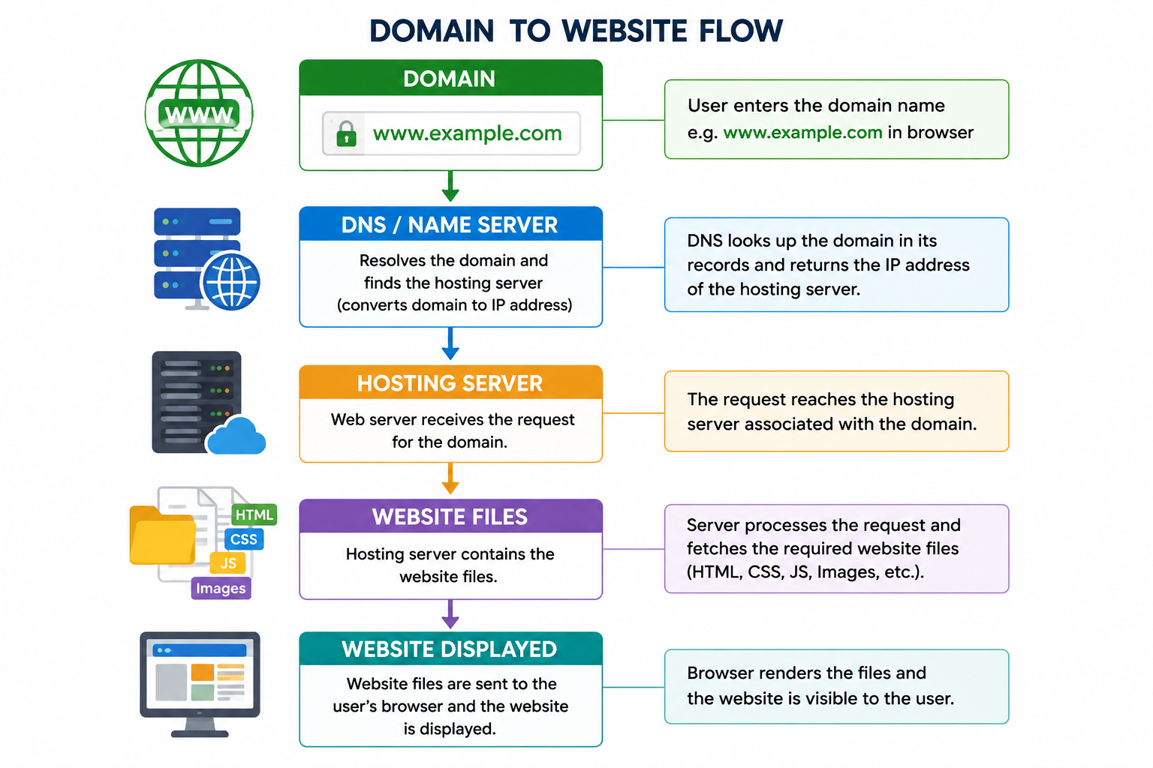
Domain and Hosting Integration

